Slide 1
CPTs 483 ROS Tutorial
Computation Graph

Slide 2
Review Graph Concept
Nodes
  Executables used by ROS to communicate with other nodes i.e. C++ programs
  {link ROS_Tutorial_IntroGraph_concept.odp /s31}
Messages
  ROS data type, published / subscribed to a topic
  {link ROS_Tutorial_IntroGraph_concept.odp/s37}
Topics
  One-way transport Nodes can publish messages and subscribe to get messages
  {link ROS_Tutorial_IntroGraph_concept.odp/s38 }
Service
  A Node service provider can publish Messages to ROS Master, Other Nodes can request the service from ROS Master
  Services are pair of struct {reply, request}
  {link ROS_Tutorial_IntroGraph_concept.odp/s42}
Master
  Links Everything in ROS helps nodes find each other. Akin to Internet DNS
  {link ROS_Tutorial_IntroGraph_concept.odp/s32 }

Slide 3
More Graph Concepts
rosout – similar to stdout / stderr (standard output )
Roscore – Master + rosout + parameter server (rosparam)
  ROS Master must be started before any other node.

Slide 4
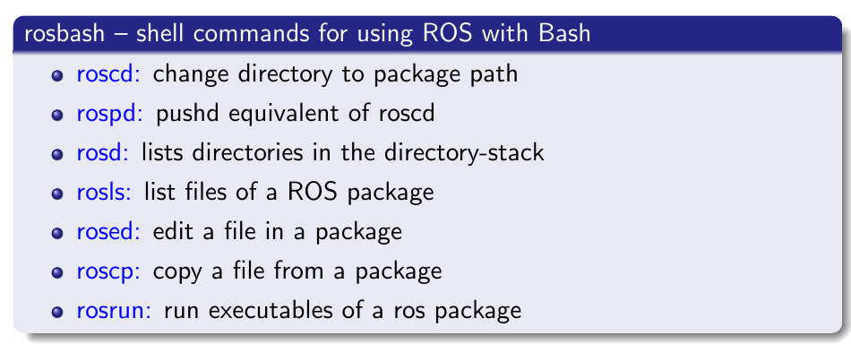
Navigating ROS File System
Filesystem tools –
  Eliminates need to use standard bash commands such as cd and ls to navigate package directories.

Slide 5
Navigating ROS File System
Using rospack
get information about packages
possible to:
  list packages currently available
  find the path of packages
  lists dependencies of packages
  and more. . .
e.g. $ rospack find turtlesim
  /opt/ros/hydro/share/turtlesim

Slide 6
roscd
Usage: roscd [package name[/subdir]]
Change to package directory
Packages must be within directories listed in ROS PACKAGE PATH
Executing roscd without specifying a package changes directory to ROS WORKSPACE (if set)

Slide 7

rosls
Usage: rosls [package name[/subdir]]
allow listing the contents of a package by name rather than by absolute path
packages must be within directories listed in ROS PACKAGE PATH

Slide 8
Understanding Nodes
rosnode
  A command line tool for printing information about ROS Nodes currently running
rosnode list
  Lists the active Nodes
rosnode info /<node name>
e.g.
$ roscore
$ rosnode list – will display a node /rosout
$ rosnode info /rosout
  Prints information about node /rosout

Slide 9
Brining up a Node
Rosrun
  Allows the use of package name to directly run a node (executable program) within the package
  Usage : rosrun [package_name] [node_name]
  e.g. $ rosrun turtlesim turtlesim_node
faustino@kubuntu:~$ rosrun turtlesim turtlesim_node
[ INFO] [1401570010.868917634]: Starting turtlesim with node name /turtlesim
[ INFO] [1401570010.885764196]: Spawning turtle [turtle1] at x=[5.544445], y=[5.544445], theta=[0.000000]

Slide 10
Activity 1: Nodes hands on
Open a terminal and run roscore
$ roscore
$ rosrun turtlesim turtlesim_node
Analyzing nodes currently running
Open a new terminal or a tab
$ rosnode list
$ rosnode info /turtlesim
$ rosnode pint /turtlesim
$ rosrun turtlesim turtlesim_teleop_keyo

Slide 11
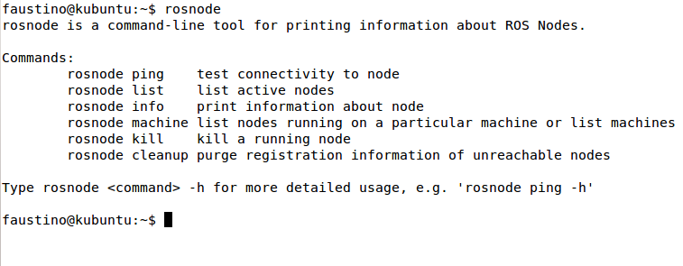
rosnode

Slide 12
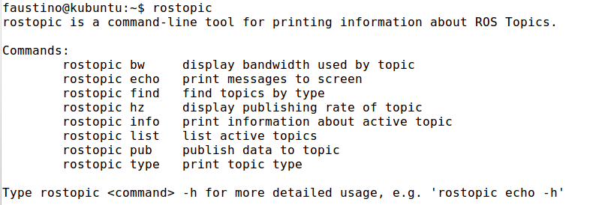
Understanding Topics

Slide 13
Activity 2 Topics Hands on
$ roscore - If not running
$ rosrun turtlesim turtlesim_node
$ rosrun turtlesim turtle_teleop_key
Getting information about topics:
$ rostopic list
$ rostopic

Slide 14
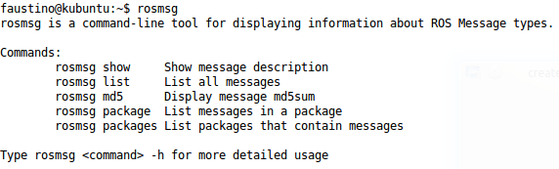
rosmsg
Command line tool for displaying information about ros message type

Slide 15
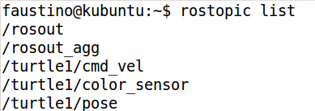
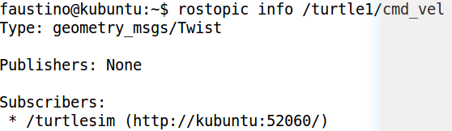
Activity 3 rosmsg
Hands on
$ roscore – if not running
$ rosrun turtlesim turtlesim_node
List active topics and get information:
$ rostopic list
$ rostopic info /turtle1/cmd_vel

Slide 16
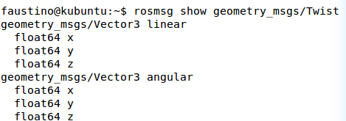
Activity 3 rosmsg
Hands on
Note!
/turtle1/cmd_vel accepts message type geometry_msgs/Twist
$ rosmsg show geometry_msgs/Twist
SO : the message type Twist is a pair of data structures
One for Linear and another for angular '[x, y, z]' '[x, y, z]'

Slide 17
Activity 3 rosmsg
Hands on
Publishing a message
Format: rostopic pub [mode] [duration] [topic] [message]
e.g.
$ rostopic pub -r 10 /turtle1/cmd_vel geometry_msgs/Twist '[2.0, 0.0, 0.0]' '[0.0, 0.0, 1.8]'
Viewing published Data:
  $ rostopic echo /turtle1/cmd_vel
  Note that $ rostopic list : will give all possible topic operations

Slide 18
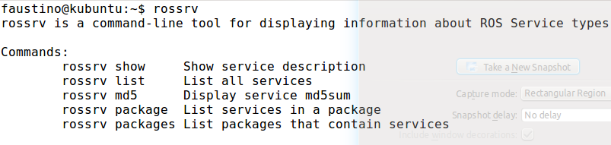
Understanding rossrv
rossrv
  A command line tool for viewing ROS service types
Usage:
$ roscore – if not already running
$ rossrv package turtlesim : lists services in package
$ rossrv show turtlesim/Spawn : show service details

Slide 19
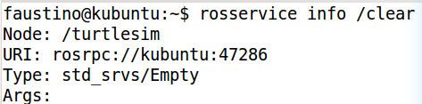
Activity 4 rossrv hands on
$ roscore – if not running
$ rossrvice list
$ rossrvice info <service name>
e.g. rosservice info /clear

Slide 20
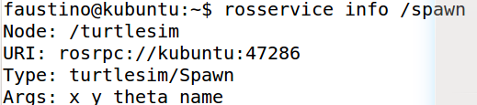
Calling ROS services
With service currently active
  Use $ rosservice list : to view active services
Use $ rosservice call to call a service
e.g.
$ rosservice call /spawn 1.0 2.0 0.0 turtle2
Now try to spawn a turtle in a different location.
Experiment will all the rosservice calls

Slide 21
ROS parameters
ROS parameter server is
  Shared Multi-variate dictionary
  Accessible via network APIs
Nodes use parameter server to store and retrieve parameters at run time
Not designed for high performance
Globally view / runs inside ROS Master
  Via XMLRPC

Slide 22
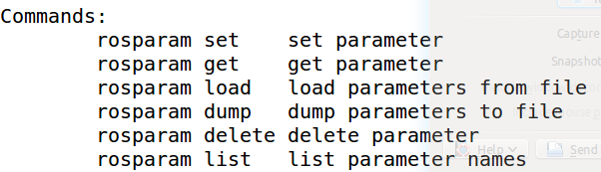
rosparm
A command line tool for getting, setting and deleting parameters from ROS parameter server

Slide 23
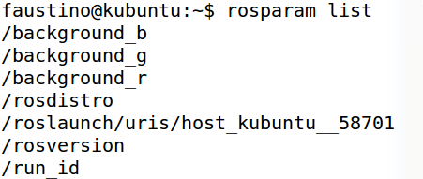
Using rosparm
rosparam list: list parameters currently stored
rosparam get [param name]: get parameter value
rosparam set [param name]: set parameter value

Slide 24
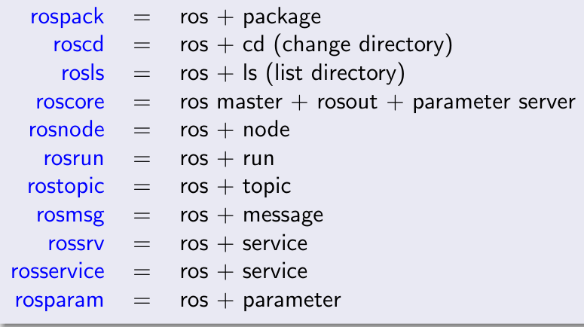
Recall

Slide 25
ROS Gui toolkit
rqt
  QT based framework for ROS
  Dock multiple widgets on a single window
  Various GUI tools implemented as plugins:
    Node graph (Introspection detailed view of nodes)
    Logging (ROS bags, Console)
    Services
    Topics
    Visualization (e.g. Plot)

Slide 26
Standalone rqt tools
(plugins)
Rqt widgets can also be executed as standalone tools
  Node Graph / rqt-graph
  Plot

Slide 27
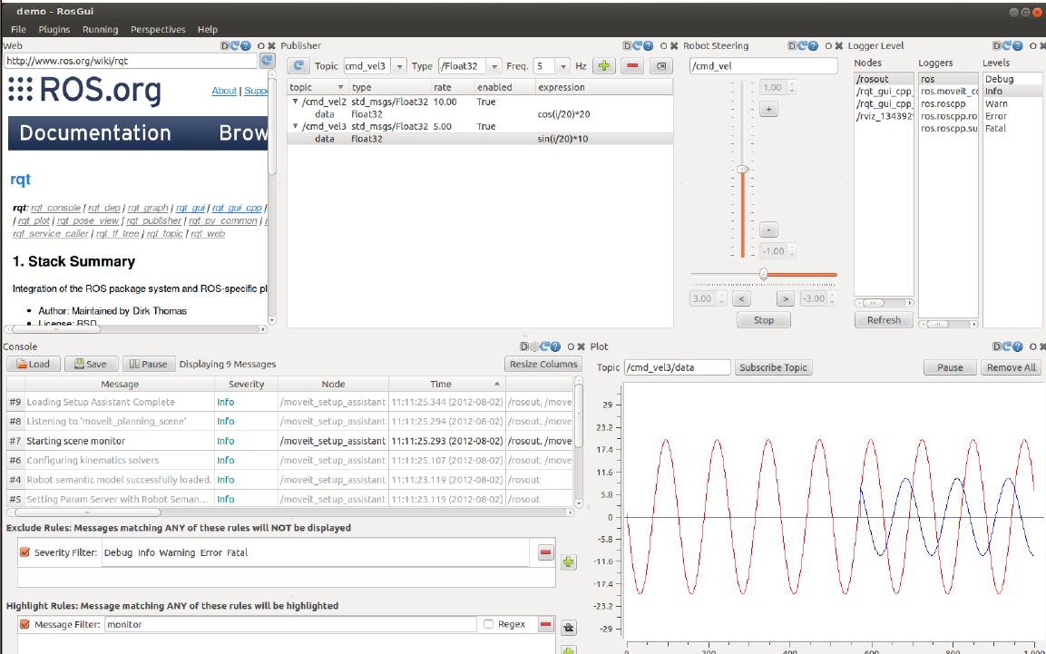
ROS Gui

Slide 28
Plotting published Data
Using rqt-graph
  Can display scrolling time plot of data published to topics
  Command : $ rosrun rqt-plot rqt-plot
e.g. Plot turtle1 pose
  $ roscore : if not running
  $ rosrun turtlesim turtlesim_node
  $ rostopic list : List the topics running
  $ rostopic type /turtle1/pose | rosmsg show
    Display the data type of published messages on /turtle1/pose topic

Slide 29
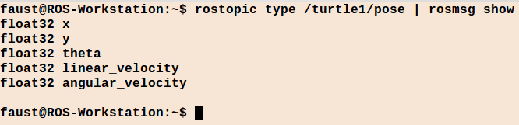
Plotting published Data
List Message types publish on /turtle1/pose topic
$ rosrun rqt_plot rqt_plot [topic]/[attribute]/[fields]
  e.g. $ rosrun rqt_plot rqt_plot /turtle1/cmd_vel/linear/x
Plot /turtle1/pose published messages:
  rosrun rqt_plot rqt_plot /turtle1/pose/x /turtle1/pose/y /turtle1/pose/z

Slide 30
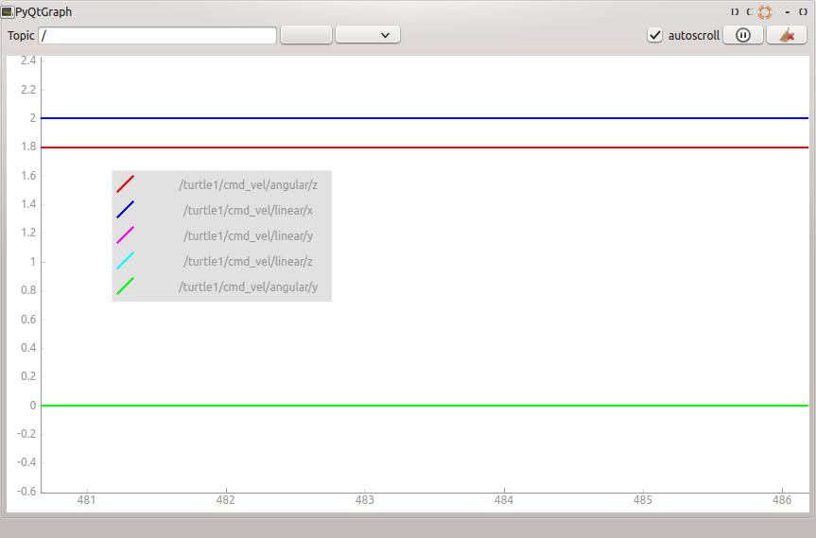
Plotting published Data
Plotting /turtle1/cmd_vel Linear x, y, z and angular z
As you can see the graph is a very accurate representation of the data published to cmd_vel topic using the command:
$ rostopic pub -r 10 /turtle1/cmd_vel geometry_msgs/Twist '[2.0, 0.0, 0.0]' '[0.0, 0.0, 1.8]'

Slide 31
rqt-graph
Reduce complexity of ROS Computation Graph
Keeps track of all nodes publishing/ subscribing
Dynamic graph of whats going on in the system
Load RQT GUI:
$ roscore
$ rosrun turtlesim turtlesim_node
$ rosrun turtlesim turtle_teleop_key
$ rosrun rqt_graph rqt_graph

Slide 32
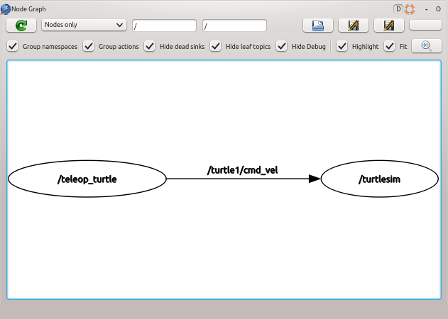
rqt_graph Example
Publishers:
  /teleop_turtle Node publishing
Message Type:
  geometry_msgs/Twist
Topics publishing/subscribed
  over /turtle1/cmd_vel topic
Subscribers
  /turtlesim node subscribe to /turtle1/cmd_vel Topic

Slide 33

More rqt_graph Example
Publishers:
  /teleop_turtle , /rostopic_1397...
  /turetlesim publishing to /turtle1/color_sensor and /turtle1/pose Topics
Message Type:
  geometry_msgs/Twist , RGB for color and x,y,theta for Pose (Run Bash commands to find exact message types)
Topics publishing/subscribed
  over /turtle1/cmd_vel topic
  /turtle1/color_sensor
  /turtle1/pose

Slide 34
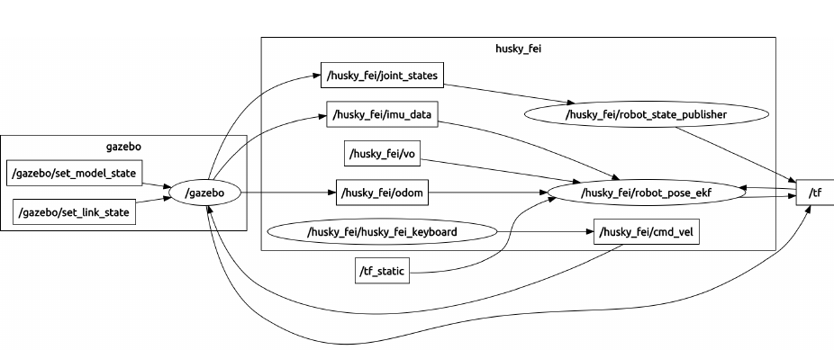
More Complex rqt_graph Example
Can you list all publishers, subscribers topics and messages

Slide 35
Review
So far....
  ROS Filesystem : rosbash commands
  ROS Nodes / Topics
  Publishing / Subscribing to topics
  rqt_plot for linear time plot of data published to topics
  rqt_graph : Overall graphical representation of the system, lists all active nodes and all topics
Next Time:
  Roslaunch commands and files

